Slide 1
ELEMENTS OF COMPUTING SYSTEMS - 2

Slide 2
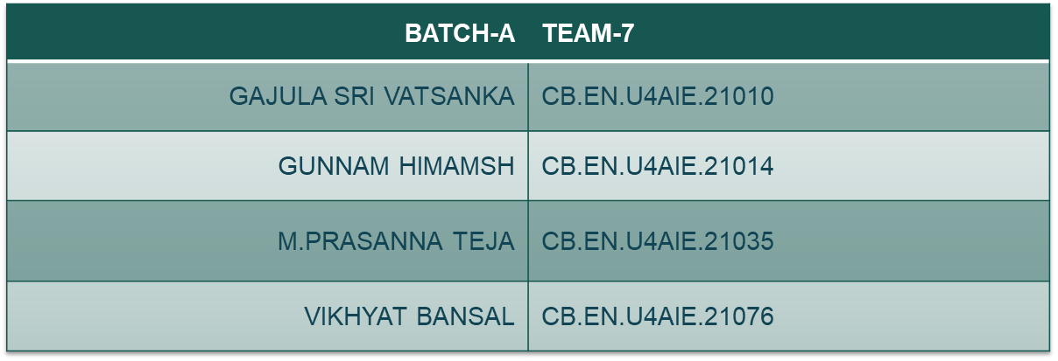
TEAM MEMBERS

Slide 3
1.
Write a Jack program to execute the following equation If n <=10, y=Σ n Else y=Σn²

Slide 4
CODE Logic
We will take a variable n whose value we will take as input from user.
If n is less than or equal to 10 then it will give summation of n from 0 to 10
If n is more than 10 then output will be given as summation of n² from 11 to till number.
NOTE: Value of n will be calculated till when n = 45 as soon as value of n is taken as n = 46. It will start the count in negative as 16 bit number integer range is from -32768 to +32767.

Slide 5
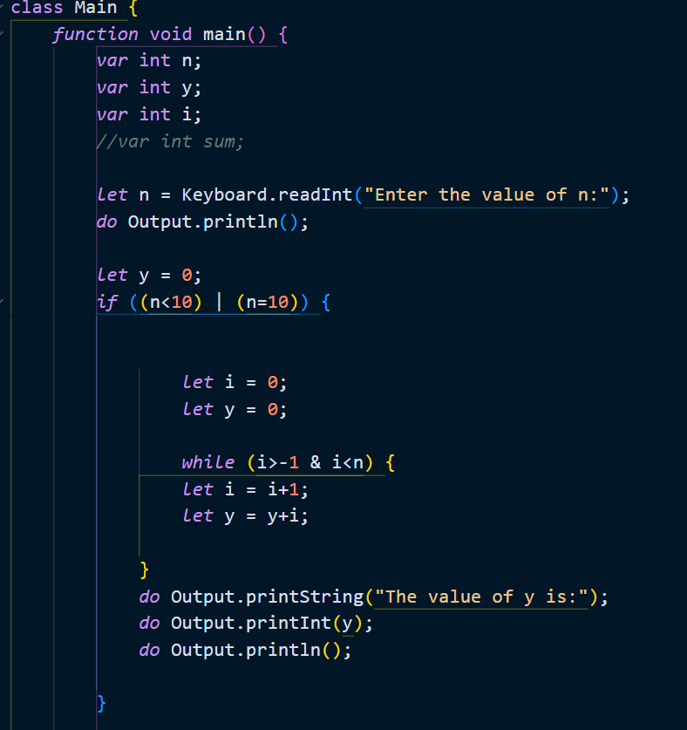
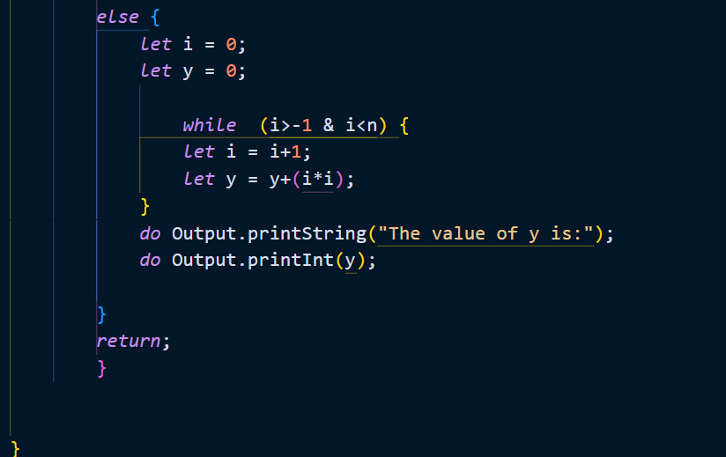
JACK CODE

Slide 6
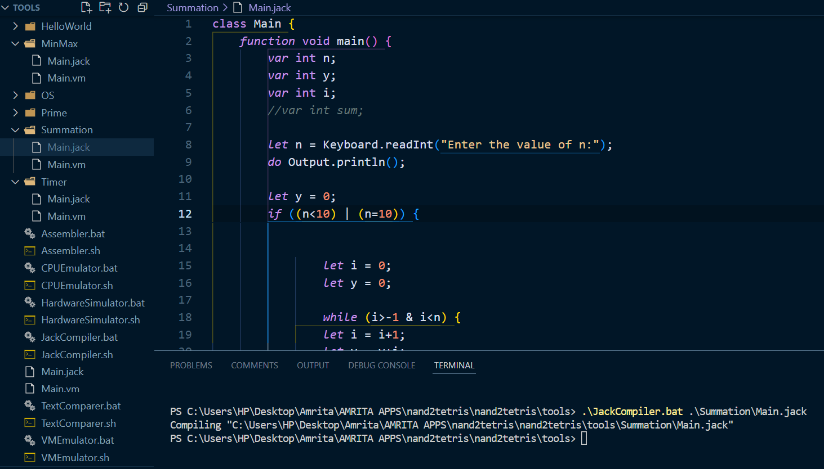
JACK COMPILATION

Slide 7
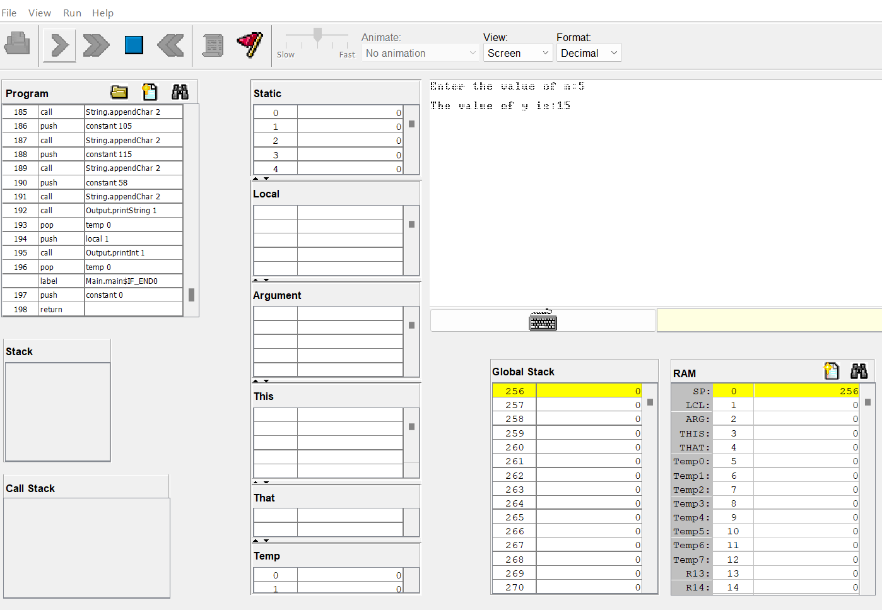
OUTPUT
When n = 5

Slide 8
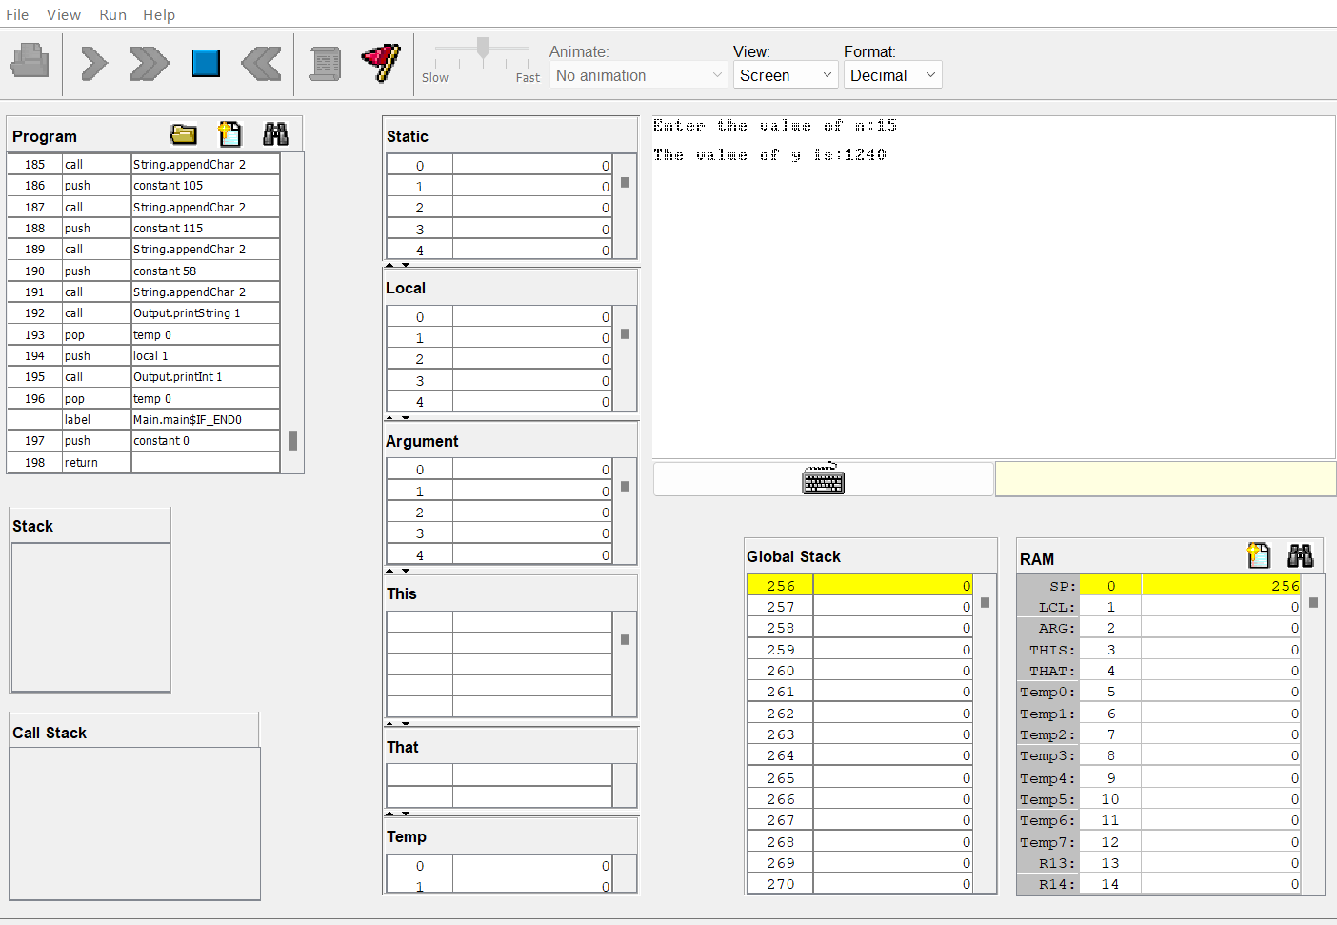
OUTPUT
When n = 15

Slide 9
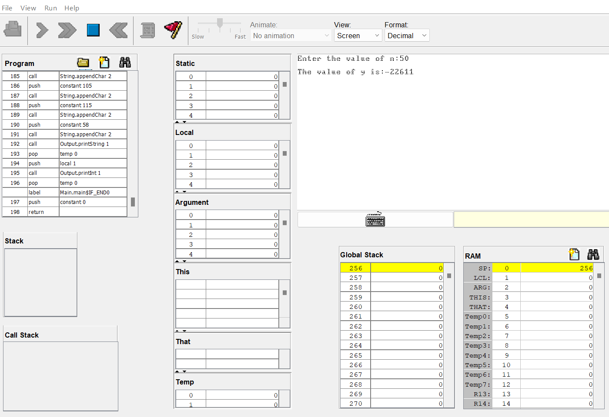
OUTPUT
When n = 50

Slide 10
2. Write a Jack program which counts up to 30 sec and automatically resets to 0.

Slide 11
CODE LOGIC
We will write a jack code which will count from 0 to 30 with a delay of 1000 millisecond (1 second).
When counter hits 30 the counter will reset and again start from 0.

Slide 12
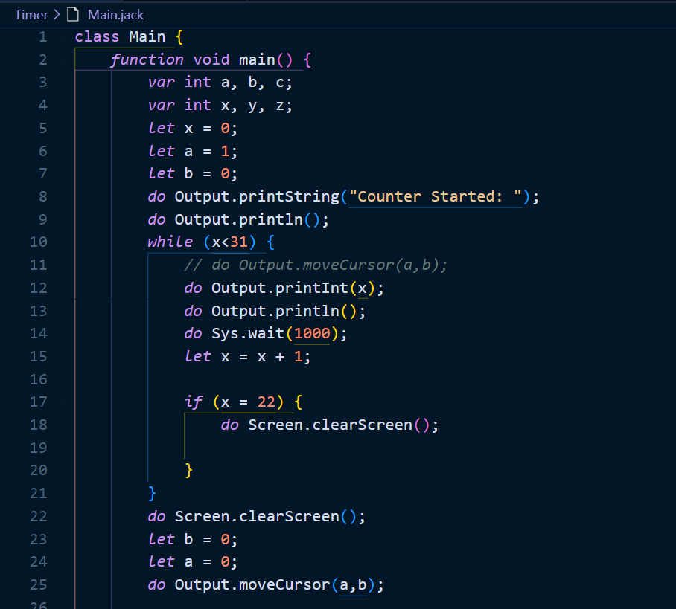
JACK CODE

Slide 13
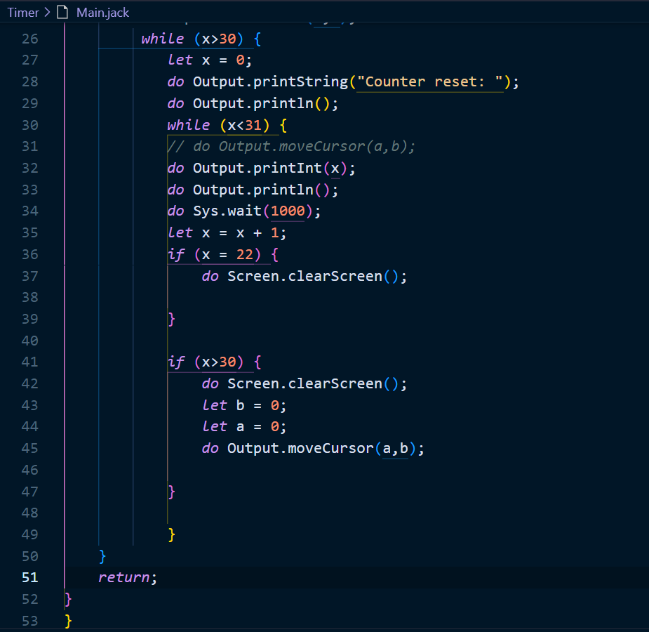

Slide 14
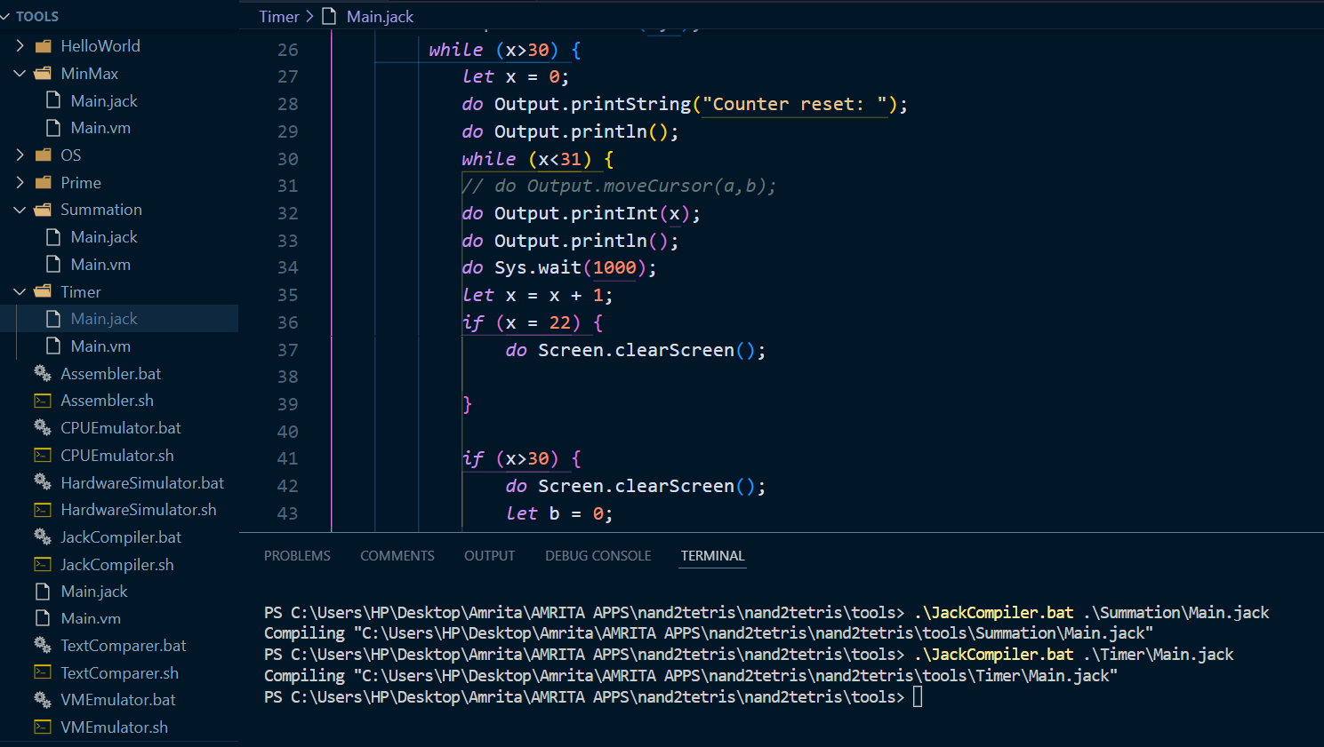
JACK COMPILATION

Slide 15
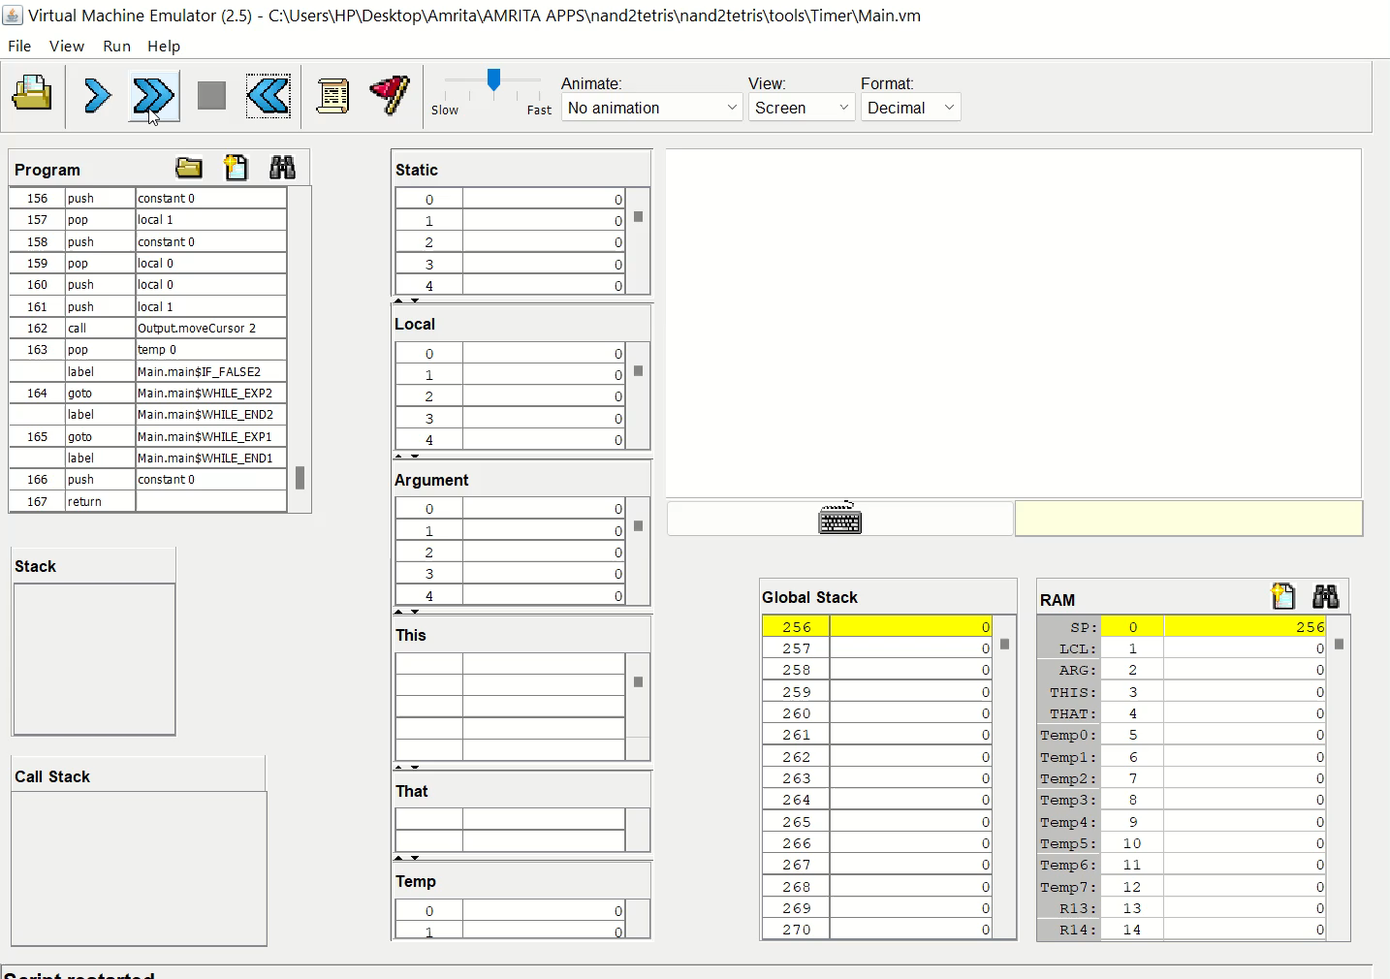
OUTPUT

Slide 16
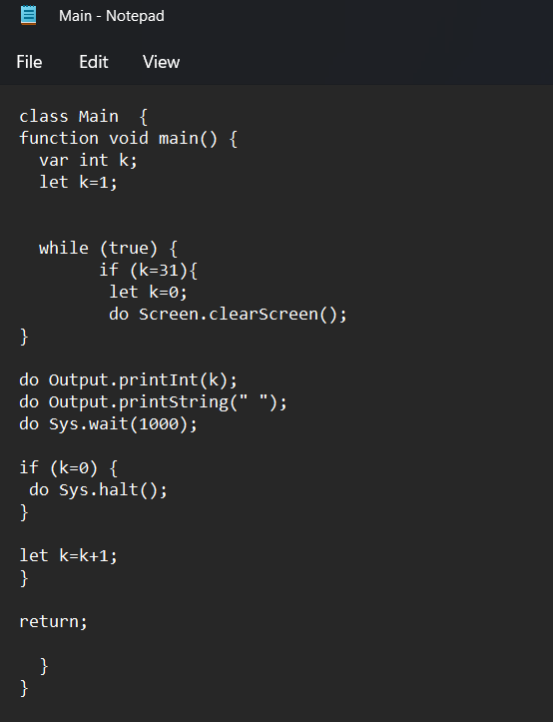
ALTERNATIVE Jack code

Slide 17
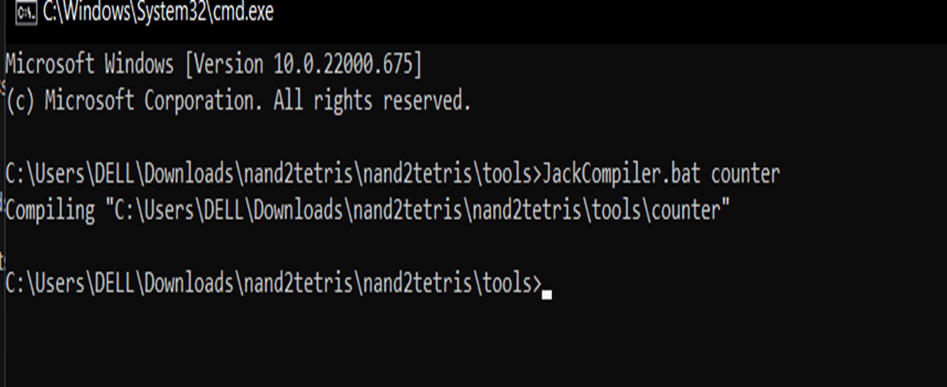
Next we have to compile that in command prompt

Slide 18
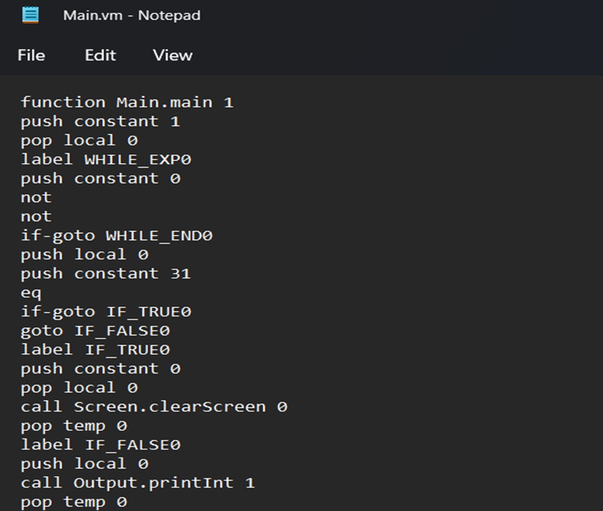
Next we can find .vm file in folder as below

Slide 19
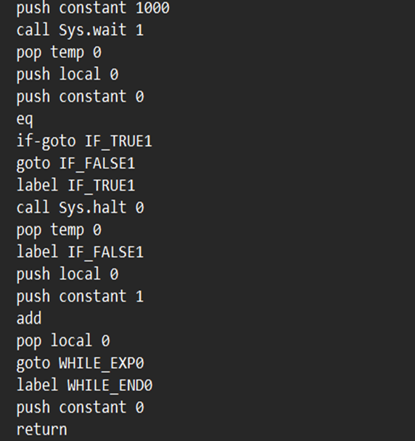
Alternative CODE

Slide 20
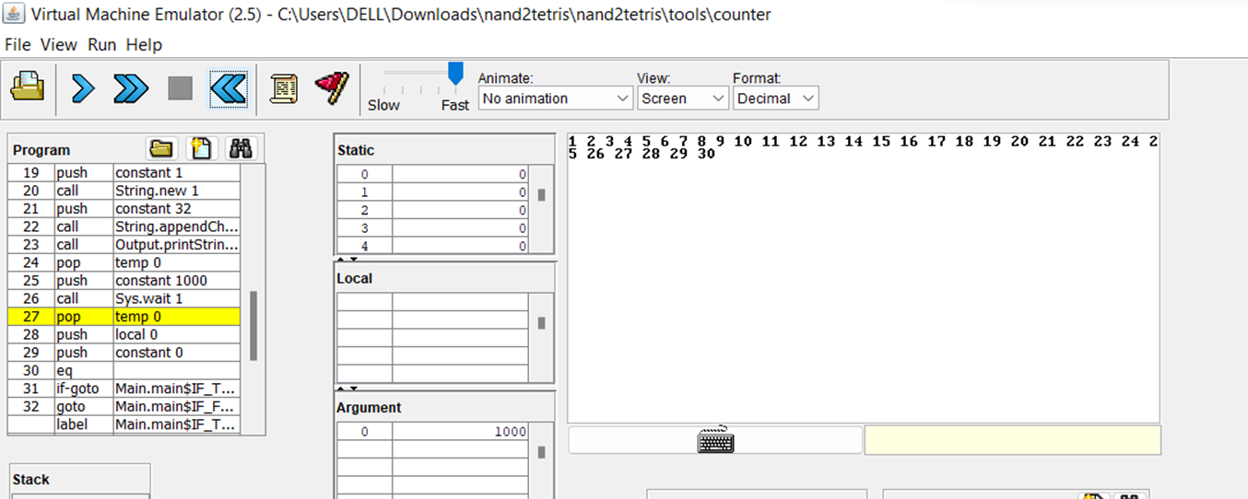
ALTERNATIVE OUTPUT

Slide 21
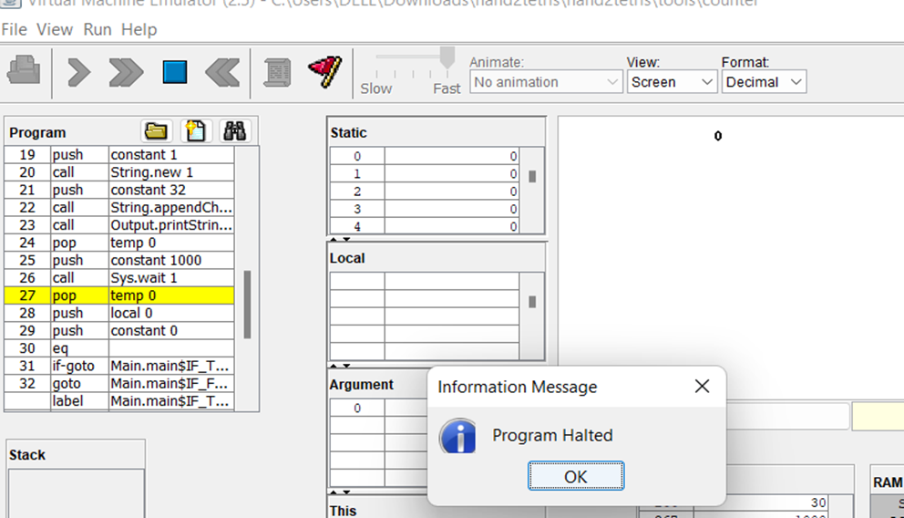
ALTERNATIVE OUTPUT

Slide 22
3. Write a Jack program to find the sum of prime numbers from 50 to 100.

Slide 23
CODE LOGIC
We will take input from user of two number that are ranging from n=50 to n=100.
Then we will check whether number starting from n = 50 till n=100 contains how many prime numbers and then add those prime numbers.

Slide 24
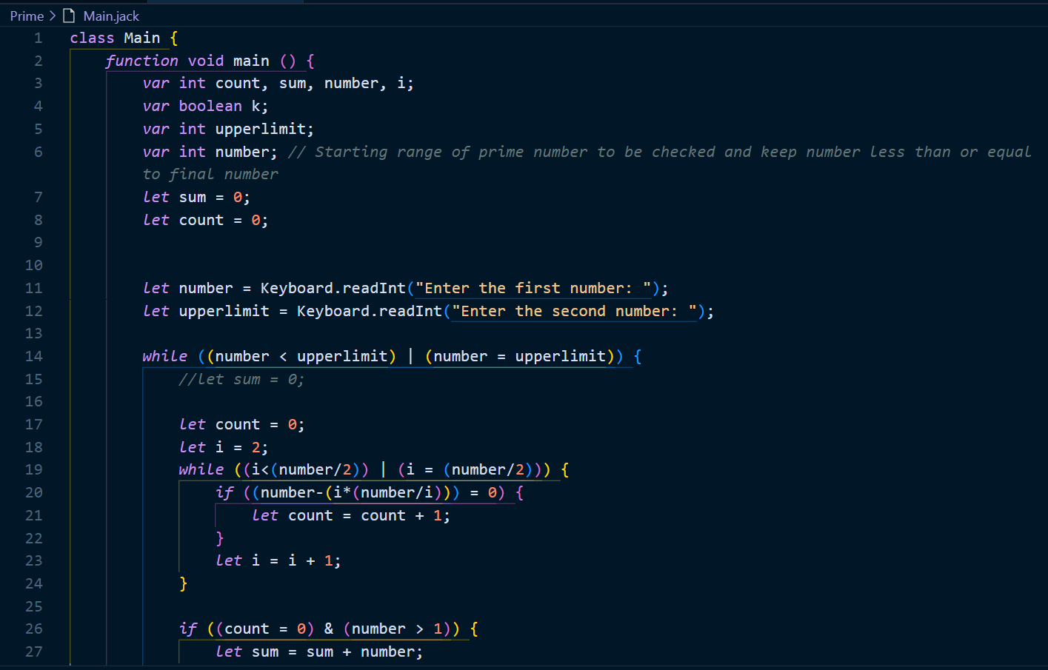
JACK CODE

Slide 25
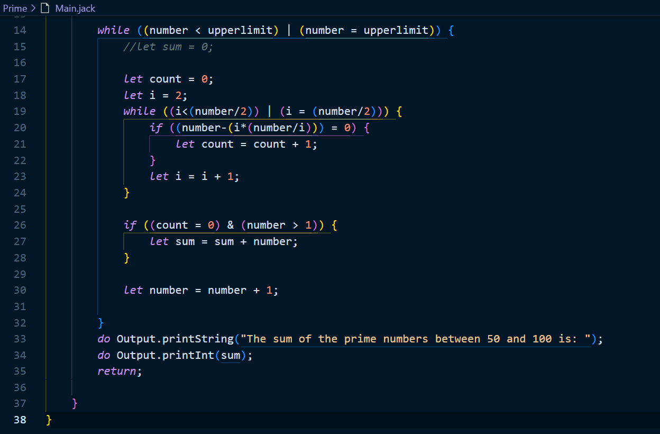
JACK CODE

Slide 26
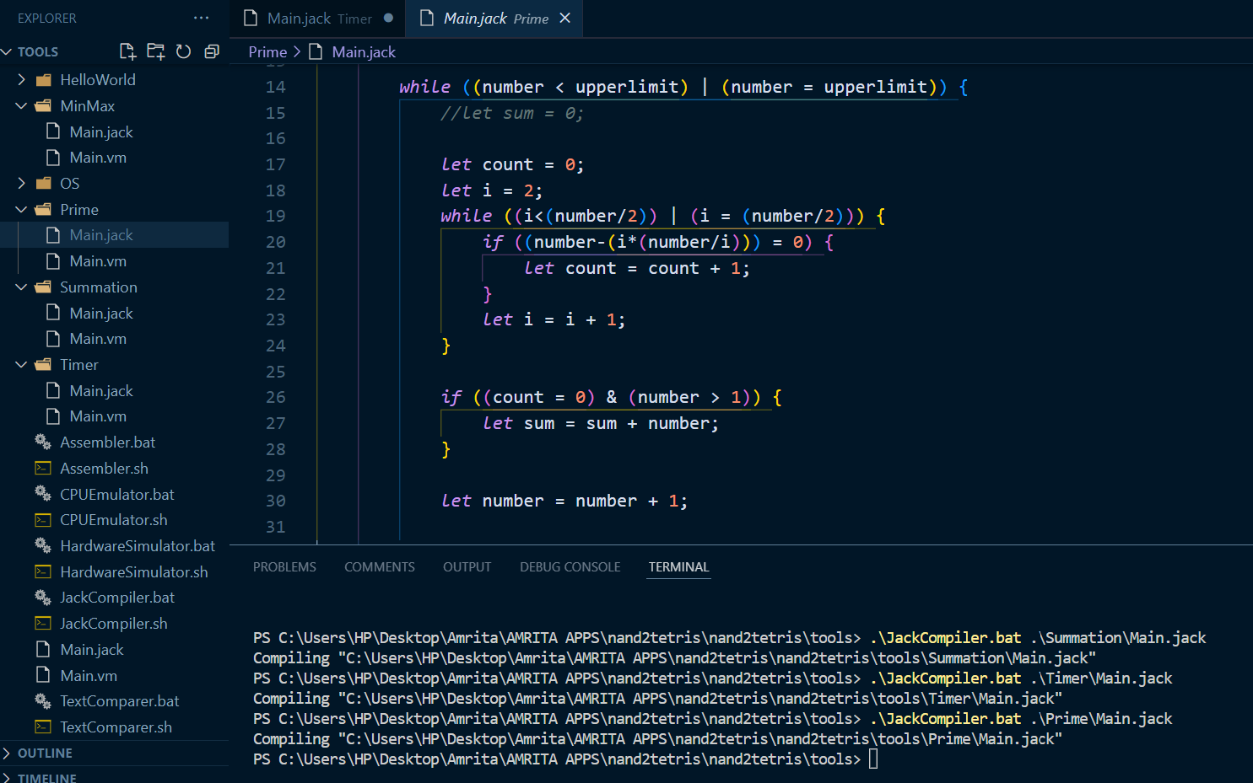
JACK COMPILATION

Slide 27
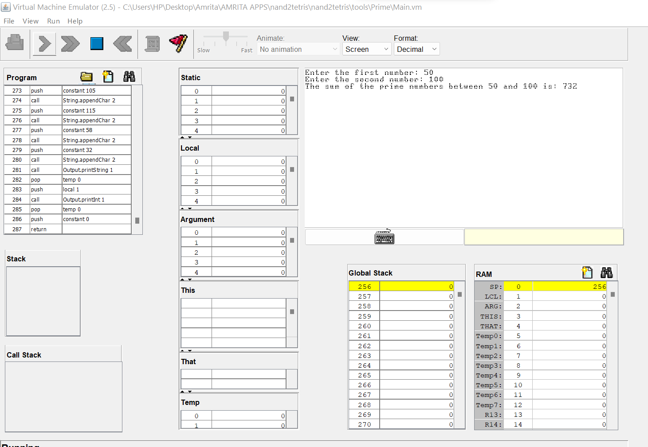
OUTPUT

Slide 28
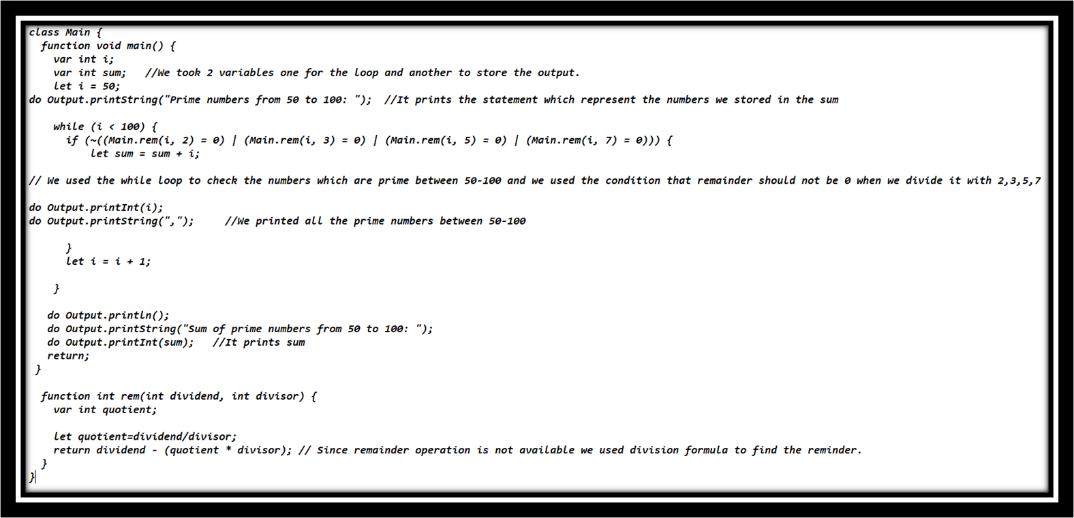
ALTERNATIVE JACK CODE

Slide 29
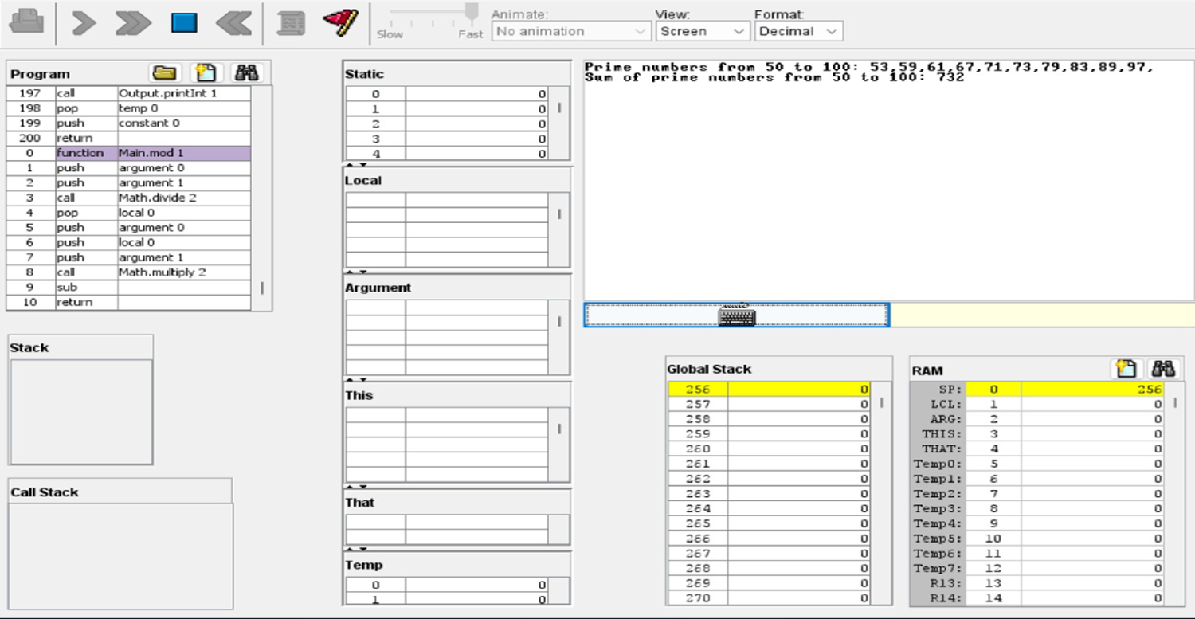
VM SIMULATION

Slide 30
4.
Write a brief description of the various Jack OS Services

Slide 31
introduction
The Jack language comes with a standard library that may also be viewed as an interface to an underlying operating system.
The library is a collection of Jack classes, and must be provided in every implementation of the Jack language.

Slide 32
The standard library includes the following classes:-
Math: Provides basic mathematical operations.
String: Implements the String type and basic.
String-related operations:-
Array: Defines the Array type and allows construction and disposal of arrays.
Output: Handles text-based output.
Screen: Handles graphic screen output.
Keyboard: Handles user input from the keyboard.
Memory: Handles memory operations.
Sys: Provides some execution-related services.

Slide 33
THANKS!

